Slide 1
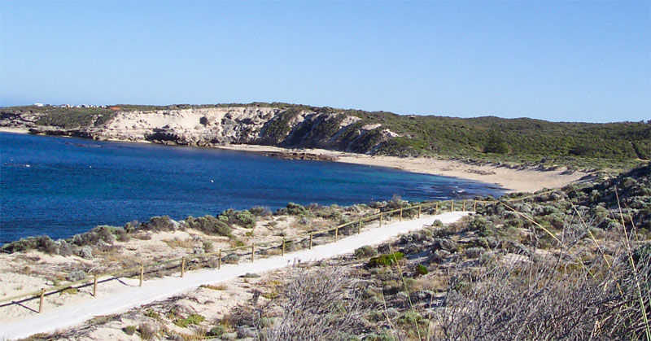
Craypots Game Instructions

Slide 2
Craypots Game Instructions
Objective: To make as much money as possible
over 12 days.
You make money by collecting crayfish using boats and craypots
Start With: 2 boats
5 Pots
You also start with $50

Slide 3
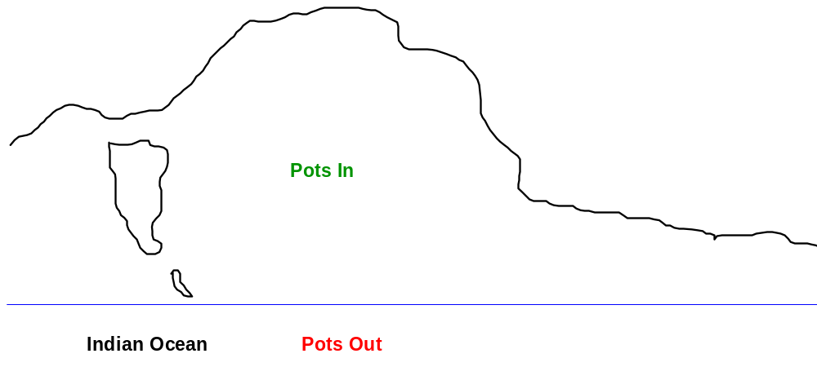
Craypots Game Instructions
A Boat Cost $100
A Pot Cost $5
Good Weather: $2 / pot
Bad Weather: $6 / pot
Good Weather: $4 / pot
Bad Weather: pots destroyed

Slide 4
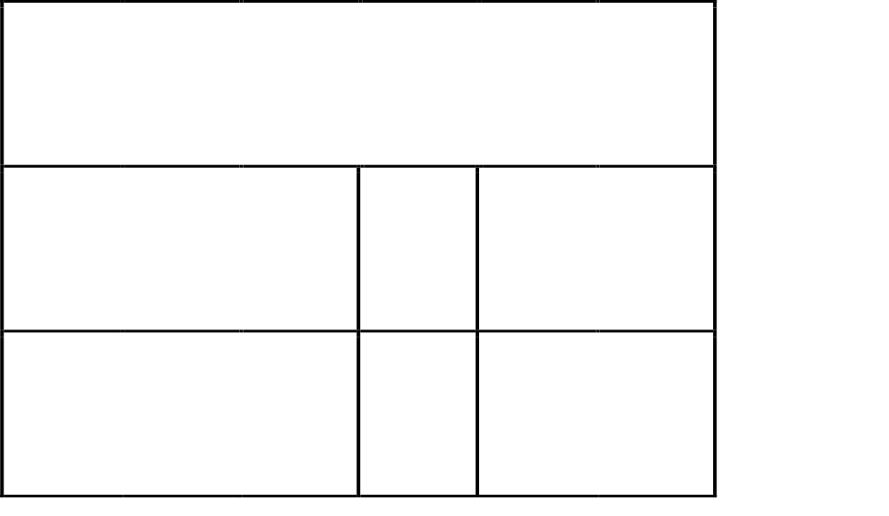
Craypots Game Instructions
Weather Die
Same as day before
Bad Weather
Good Weather

Slide 5
Craypots Game Instructions
Tips: Don’t put all your pots in the one place
The more pots you have the more money you can make. So buy as many pots as possible (this requires you buying boats too)
Remember: Maximum of 10 pots per 1 boat.
The probability of better weather is greater
then it being bad weather, but only just

Slide 6
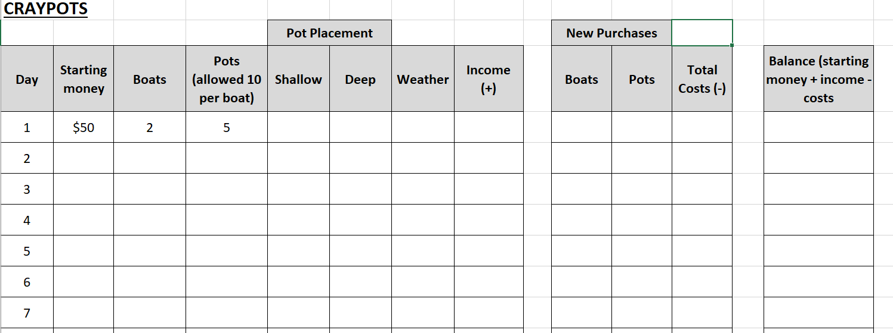
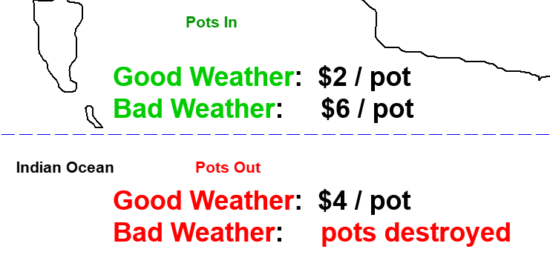
A Boat Cost $100
A Pot Cost $5
Remember: Maximum of 10 pots per 1 boat.

